Slide 1

State Management in ASP.NET
Stefan Dobrev
National Academy for Software Development
academy.devbg.org

Slide 2

Contents
Intrinsic Objects
Standard Mechanisms
  Cookies
  Hidden Fields
  Parameterized Addresses
Page Execution Lifecycle
ASP.NET Based Mechanisms
  ApplicationState
  Session
  ViewState
Manipulating response headers

Slide 3
Intrinsic Objects in ASP.NET
Application (HttpApplication class)
Session (HttpSession class)
Request (HttpRequest class)
Response (HttpResponse class)
Server (HttpServerUtility class)
Context (HttpContext class)
Cache (System.Web.Caching.Cache class)
Notes:
<number>##
<footer>*
<header>*
Бележки на автора:
Вградени обекти в ASP.NET
Application (HttpApplication class)
Session (HttpSession class)
Request (HttpRequest class)
Response (HttpResponse class)
Server (HttpServerUtility class)
Context (HttpContext class)
Cache (System.Web.Caching.Cache class)

Slide 4
HttpApplication
Provides access to other intrinsic objects
  Properties Application, Context, Request, Response, Server, Session etc.
Subscribe events for:
  Start of a new request
  Authentication
  Authorization
  Working with the cache
  End of a Request

Slide 5
HttpRequest
Contains information regarding the current request
  ApplicationPath
  Browser
  Cookies
  HttpMethod
  QueryString
  ServerVariables
  Url
  SaveAs(…)
  ValidateInput(…)

Slide 6
HttpResponse
Contains information about the current response
  BufferOutput
  Charset
  Cookies
  Expires
  AddCacheDependency (…)
  AddHeader(…)
  BinaryWrite(…)
  ClearHeaders(…)
  Write(…)

Slide 7
HttpServerUtility
Provides helper methods for processing Web requests
  HtmlEncode()
  HtmlDecode()
  UrlEncode()
  UrlDecode()

Slide 8
Example
bool isSecureConnection =
Request.IsSecureConnection;
Application.Add("key", "value");
string strEncoded =
Server.UrlEncode("Zagorka");
Response.ContentType = "text/html";
string imageFileName =
Server.MapPath("img/logo.gif");
MyLabel.Text = Server.HtmlEncode(str);
Notes:
<number>##
<footer>*
<header>*
Бележки на автора:
Примерна употреба
bool isSecureConnection = Request.IsSecureConnection;
Application.Add("key", "value");
string strEncoded = Server.UrlEncode("Загорка");
Response.ContentType = "text/html";

Slide 9
Redirecting The Output
Response.Redirect("Login.aspx")
  Client redirection
  Changes the address in the browser
Server.Transfer("WebTest.aspx")
  Server redirection
  Keeps the URL in the browser
  The browser doesn’t understand about the redirection
Notes:
<number>##
<footer>*
<header>*
Бележки на автора:
Пренасочване на изхода
Response.Redirect("Login.aspx") - Пренасочване от страна на клиента (client redirection). Променя адреса на Web браузъра.
Server.Forward("WebForm1.aspx") - Пренасочване от страна на сървъра (server redirection). Запазва адреса на Web браузъра. На практика Web браузърът не разбира за пренасочването.

Slide 10
Client and Server Redirection
Live Demo

Slide 11
Page Execution Lifecycle

Slide 12
Page Execution Lifecycle
On the server side, ASP.NET web form goes through several stages:
  Page framework initialization
  User code initialization
  Validation
  Event handling
  Automatic data binding
  Cleanup

Slide 13
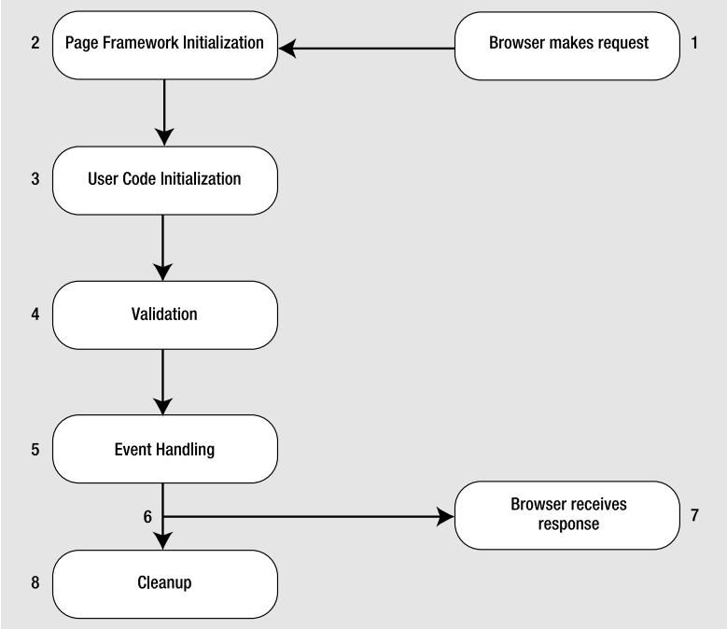
Page Execution Lifecycle (1)

Slide 14
Page Execution Lifecycle(2)
Page Framework Initialization:
  Generates all the controls you have defined
  If page is postback, ASP.NET deserializes the view state information and applies it to the controls
  Page.Init Event fires

Slide 15
Page Execution Lifecycle(3)
User Code Initialization:
  Here you can perform any required initialization (ex. filling in dynamic text or configuring controls)
  Always fires Page.Load event
    Page.IsPostBack – commonly used in it
Validation:
  All validation controls are checked and Page.IsValid property is set

Slide 16
Page Execution Lifecycle(4)
Event Handling:
  All Control Events such TextBox.TextChanged, Button.Click, Page.PreRender are triggered
Automatic Data Binding:
  After the Page.PreRender event fired
  Data source controls executes theirs queries and insert the data into controls
  Data source Selecting and Selected are fired
Cleanup:
  At the end page is rendered as HTML and Page.Disposed event is fired

Slide 17
Page Execution Lifecycle
Live Demo

Slide 18
ASP.NET
Based Mechanisms

Slide 19
State Management
HTTP is a stateless protocol
  In order to tell whether a request comes from a previous client we need a mechanism over the HTTP protocol
A number of standard ways to identify clients
ASP.NET offers both standard and upper level mechanisms to manage state

Slide 20
Standard Mechanisms - Cookies
A small piece of information (4KB)
  Sent to a browser by a web server
Saved locally at the client as a text file (can be deleted)
Sent as an HTTP header
Set-Cookie: UserID=StefanDobrev; path=/; domain=devbg.org; Expires=Saturday, 17-Jan-07 00.00.01 GMT
Cookie: UserID: StefanDobrev;

Slide 21
Cookie Properties
Expires – sets when the validity of the cookie expires
Domain – a domain of internet addresses to which the cookie can be sent
Path – sets the top level directory from which a cookie can be read (it won’t be sent to directories higher in the hierarchy)

Slide 22
Working With Cookies
For client applications
  System.Net.Cookie
For web applications
  System.Web.HttpCookie
HttpRequest.Cookies contains the cookies received by the server
HttpResponse.Cookies contains the cookies sent to the browser

Slide 23
Working With Cookies - Example
Creating a cookie that will be sent to the browser:
Reading a cookie received at the server:
HttpCookie cookie = new HttpCookie("UserName", "ligAZ");
Response.Cookies.Add(cookie);
HttpCookie cookie = Request.Cookies["UserName"];

Slide 24
Standard Ways - II
Hidden fields
  Use the web server control HiddenField
Parameterized URLs
  Setting the parameters in the URL of a page after the ‘?’ sign
<input type="hidden" name="Language" value="English">
http://asp.net/getstarted/default.aspx?tabid=61
string selectedTabID = Request.QueryString["tabid"];

Slide 25
Standard Mechanisms - Cookies
Live Demo

Slide 26
Application State
Shared storage of information at application level (one for all users)
HttpApplicationState – dictionary collection accessed through HttpContext or Page
Available through all phases of the application life cycle
In order to have synchronized access we use the Lock() and Unlock()methods
Application.Lock();
Application["Users"] = (int) Application["Users"] + 1;
Application.UnLock();

Slide 27
Application State (2)
Application State is rarely used in reality (unlike the cache)
Supported only for the sake of the pure ASP

Slide 28
Application State
Live Demo

Slide 29
Session State
Storage of information at user level (different one for each user)
The session is active:
  Till the user closes the browser or
  A certain period expires (20 minutes for example)
Every session is identified by a unique SessionID
  Created at first entry in the site
  Transmitted in a cookie by default

Slide 30
Session State (2)
The HttpSessionState dictionary collection is used through HttpContext or Page
To handle events fired when a session is started or ended we use Session_OnStart and Session_OnEnd in the Global.asax file
To deny/restrict access to the session
<%@ Page EnableSessionState="False" %>
<%@ Page EnableSessionState="ReadOnly" %>

Slide 31

Session Configuration
We can configure various aspects of the session mechanism
Use the sessionState section in web.config
Example:
<system.web>
<sessionState
cookieless="true" mode="InProc"
timeout="60" cookieName="MySite" />
</system.web>

Slide 32
Session Configuration (2)
Important attributes
  Timeout – a period for which the session is active
  Mode – where the session is saved – in the current process, SQL Server, State Server (separate process)
  Cookieless – a session that doesn’t use cookies – SessionID is a parameter in the URL

Slide 33
Session State
Live Demo

Slide 34
ViewState
Enables us to keep the state of the controls over several consecutive requests to the same page (Postbacks)
Every change in the visualization of a control (adding an element to a list control for example) is saved in the ViewState
Can save data defined by us
ViewState["Username"] = txtUsername.Text.Trim();
lblUsername.Text = ViewState["Username"];

Slide 35
ViewState – Behind the Scene
Information saved in the ViewState is serialized and sent to the user in a hidden field
At Postback information is deserialized and the state of controls is restored
To accomplish serialization the ObjectStateFormatter class is used
<input type="hidden" name="__VIEWSTATE" id="__VIEWSTATE"
value="/wEPDwUJODExMDE5NzY5D2QWAgIDD2QWAgIBDw8WA
h4EVGV4dAUFS296bW9kZGR67yT0OasTSUMlwIXGj65FNx7ggA==" />

Slide 36
ViewState Configuration
To disable ViewState
  At Page level
  At control level
To edit the ViewState:
To save the ViewState at the server we can use SessionPageStatePersister
<%@ Page EnableViewState="false" %>
<asp:Label ID="lblName" Runat="server" Text="ligAZ"
EnableViewState="False" />
<%@ Page ViewStateEncryptionMode="Always" %>

Slide 37
Viewing The ViewState
Hidden Field
Live Demo

Slide 38
Recommendations
Use a wrapper class over the session
Don’t save too much information in the session
Don’t save lots of information in the ViewState

Slide 39
Manipulating Response Headers

Slide 40
Manipulating Response Headers
Part of the server response
Allow the server to pass additional information about the response
  Page content, caching, cookies, http codes etc.
Give information about the server and about further access to the resource identified by the Request-URI
Accessible from code behind through Response.Headers collection

Slide 41
Manipulating Response Headers (2)
Some Response Header Members:
  HeaderEncoding – sets header encoding
  Headers – read only collection of headers
  ContentType – HTTP MIME type of the output
  Expires – numbers of minutes before page cached in browser expires
  StatusCode – Http Status code of the output
  AppendHeader()- Adds an HTTP header to the output stream

Slide 42
Manipulating Response Headers - Example
Downloading image file generated from the page:
Response.Clear();
Bitmap generatedImage = new Bitmap(200, 200);
Graphics gr = Graphics.FromImage(generatedImage);
gr.FillRectangle(Brushes.MediumSeaGreen, 0, 0, 200, 200);
gr.FillPie(Brushes.Yellow, 25, 25,150, 150, 0, 45);
gr.FillPie(Brushes.Green, 25, 25, 150, 150, 45, 315);
//set response header and write the image into response stream
Response.ContentType = "image/gif";
generatedImage.Save(Response.OutputStream,ImageFormat.Gif);

Slide 43
Manipulating Response Headers
Live Demo

Slide 44
State Management
Questions?

Slide 45
Exercises
Create an HTML page, which prints the type of the browser, the IP and the port which the client uses to access the page
Create a web page which saves the input of a text field when a button is clicked in the Session object and then prints it in a Label control
Create two pages that exchange user input data with cookies. The first page is a login page. The second one should redirect to the first one if there’s no cookie. The cookie must expire in 1 minute

Slide 46
Exercises (2)
Create a javascript function that deletes the ViewState hidden field variable. What happens at postback?

